Slide 1
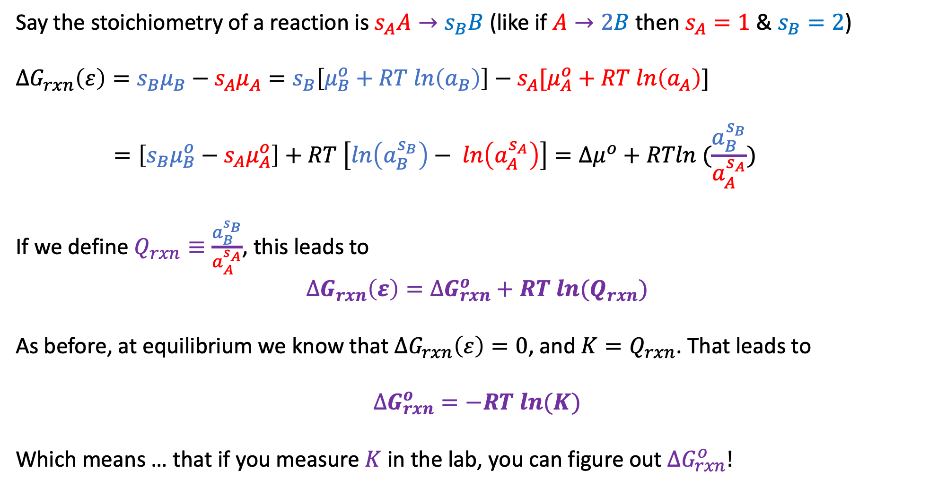
2. Generalizing the connection between ${\left(\frac{∂G}{∂ε}\right)}_{rxn}$, $∆G_{rxn}\left(ε\right)$, $Q$, and $K$
Say the stoichiometry of a reaction is $s_{A}A→s_{B}B$ (like if $A→2B$ then $s_{A}=1$ & $s_{B}=2$)
$$∆G_{rxn}\left(ε\right)={s_{B}μ}_{B}−{s_{A}μ}_{A}=s_{B}\left[μ_{B}^{o}+RT ln\left(a_{B}\right)\right]−s_{A}[μ_{A}^{o}+RT ln\left(a_{A}\right)]$$
$$=\left[s_{B}μ_{B}^{o}−{s_{A}μ}_{A}^{o}\right]+RT \left[ln\left(a_{B}^{s_{B}}\right)− ln\left(a_{A}^{s_{A}}\right)\right]=∆μ^{o}+RTln (\frac{a_{B}^{s_{B}}}{a_{A}^{s_{A}}})$$
If we define $Q_{rxn}≡\frac{a_{B}^{s_{B}}}{a_{A}^{s_{A}}}$, this leads to
$$∆G_{rxn}\left(ε\right)=∆G_{rxn}^{o}+RT ln{(Q}_{rxn})$$
As before, at equilibrium we know that $∆G_{rxn}\left(ε\right)=0$, and ${K=Q}_{rxn}$. That leads to
$$∆G_{rxn}^{o}=−RT ln(K)$$
Which means … that if you measure $K$ in the lab, you can figure out $∆G_{rxn}^{o}!$

Slide 2
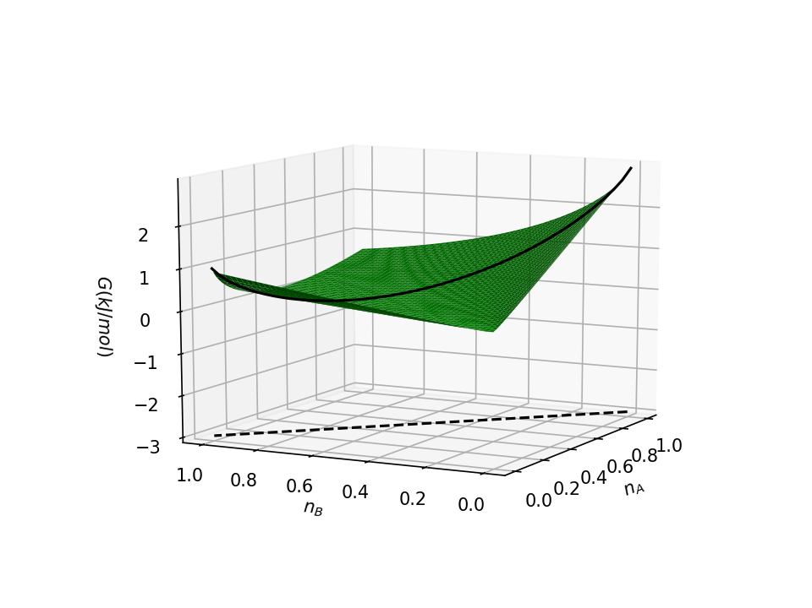

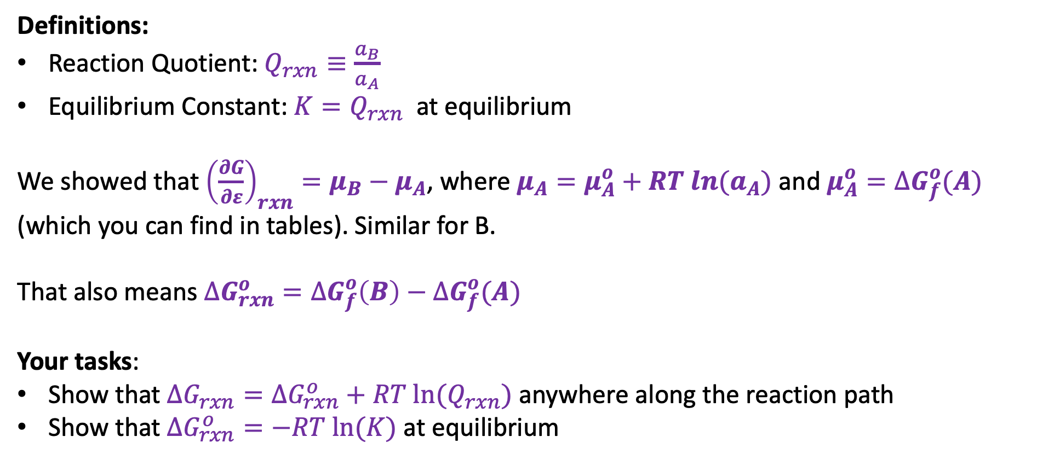
2. Connecting ${\left(\frac{∂G}{∂ε}\right)}_{rxn}$, $∆G_{rxn}\left(ε\right)$, $Q$, and $K$
Definitions:
Reaction Quotient: $Q_{rxn}≡\frac{a_{B}}{a_{A}}$
Equilibrium Constant: ${K=Q}_{rxn}$ at equilibrium
We showed that ${\left(\frac{∂G}{∂ε}\right)}_{rxn}=μ_{B}−μ_{A}$, where $μ_{A}=μ_{A}^{o}+RT ln{(a}_{A})$ and $μ_{A}^{o}=∆G_{f}^{o}(A)$ (which you can find in tables). Similar for B.
That also means $∆G_{rxn}^{o}=∆G_{f}^{o}\left(B\right)−∆G_{f}^{o}(A)$
Your tasks:
Show that $∆G_{rxn}=∆G_{rxn}^{o}+RT ln⁡(Q_{rxn})$ anywhere along the reaction path
Show that $∆G_{rxn}^{o}=−RT ln⁡(K)$ at equilibrium
$$ε$$

